Slide 1
Visual Summary of Implementations
AC299r Fall 2014

Slide 2
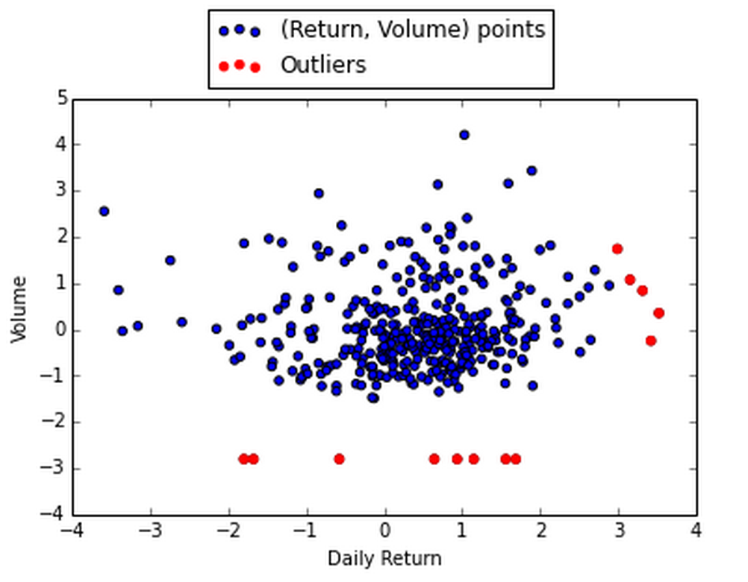
LOCI – Stock
alpha = 0.5
K_sigma =3

Slide 3
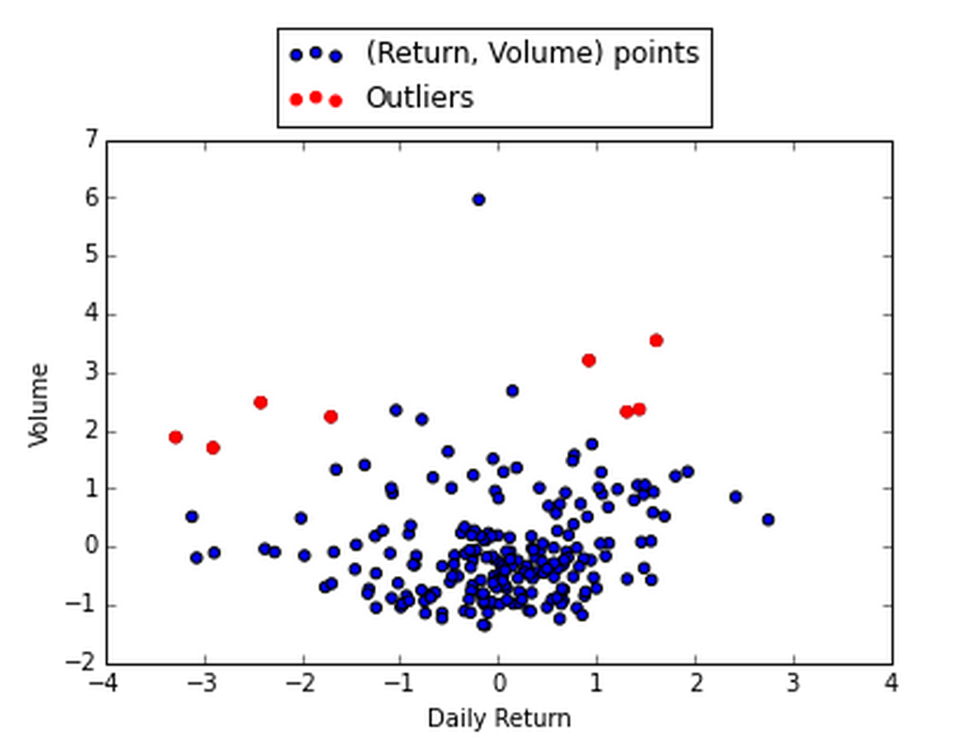
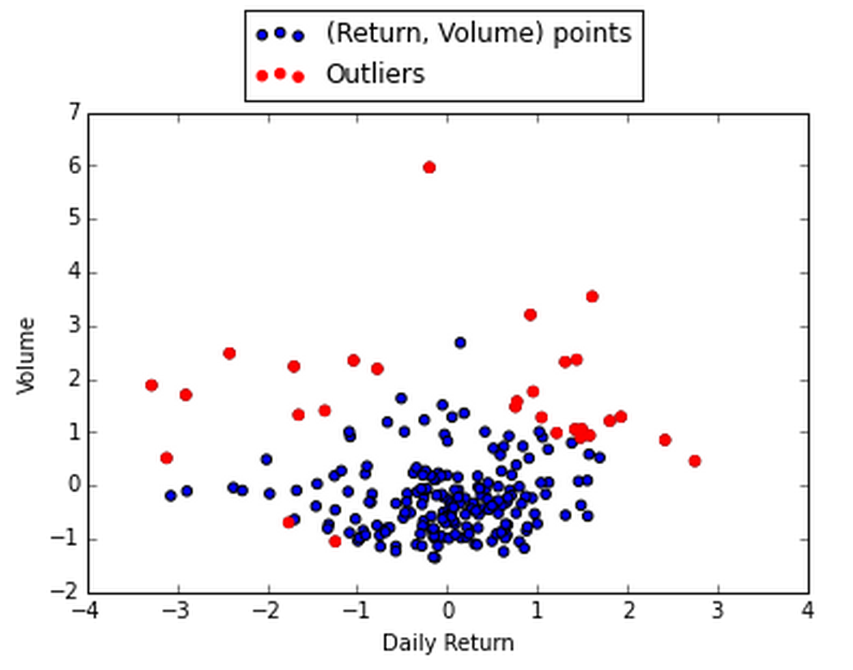
Mixture Model – Normal/Unif, Stock
Thresh = 5.5
Thresh = 4.6

Slide 4
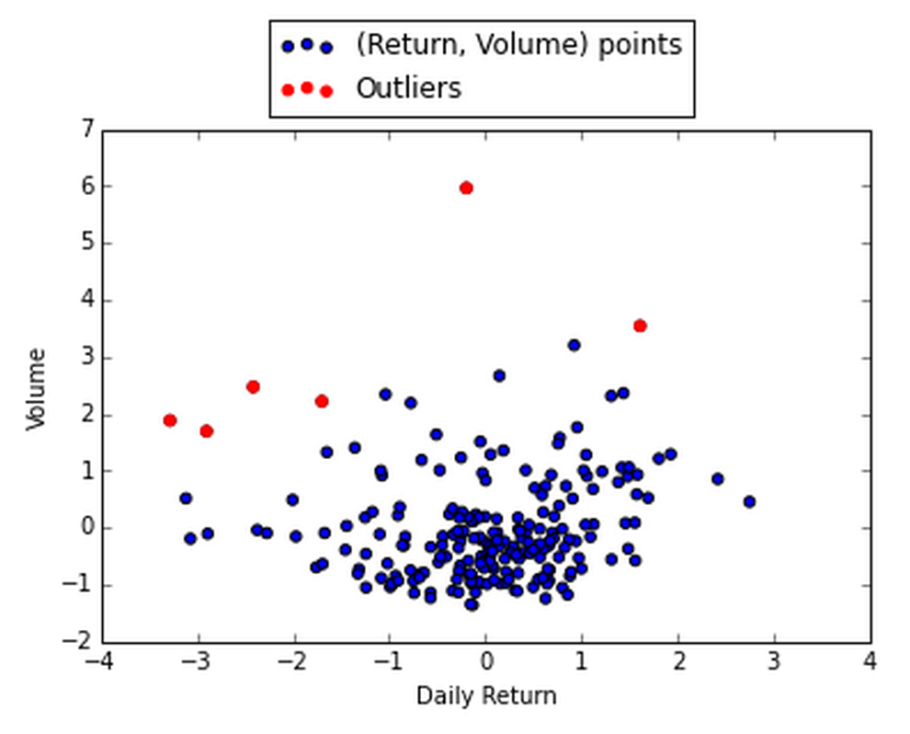
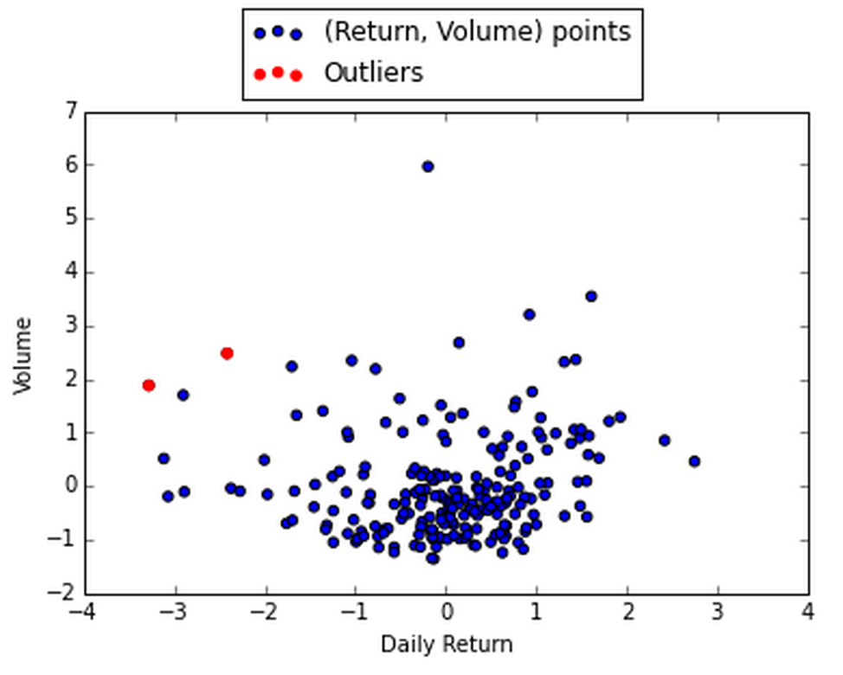
Regression Difference
thresh: 3
thresh: 5

Slide 5
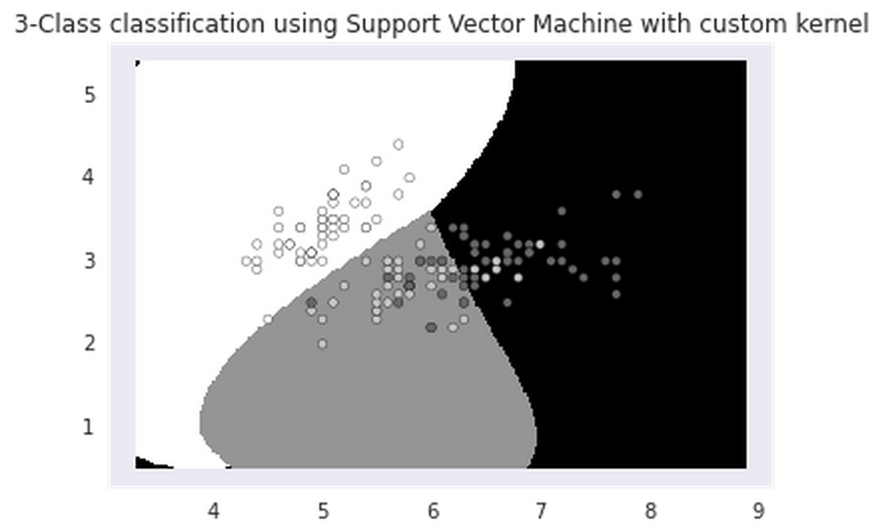
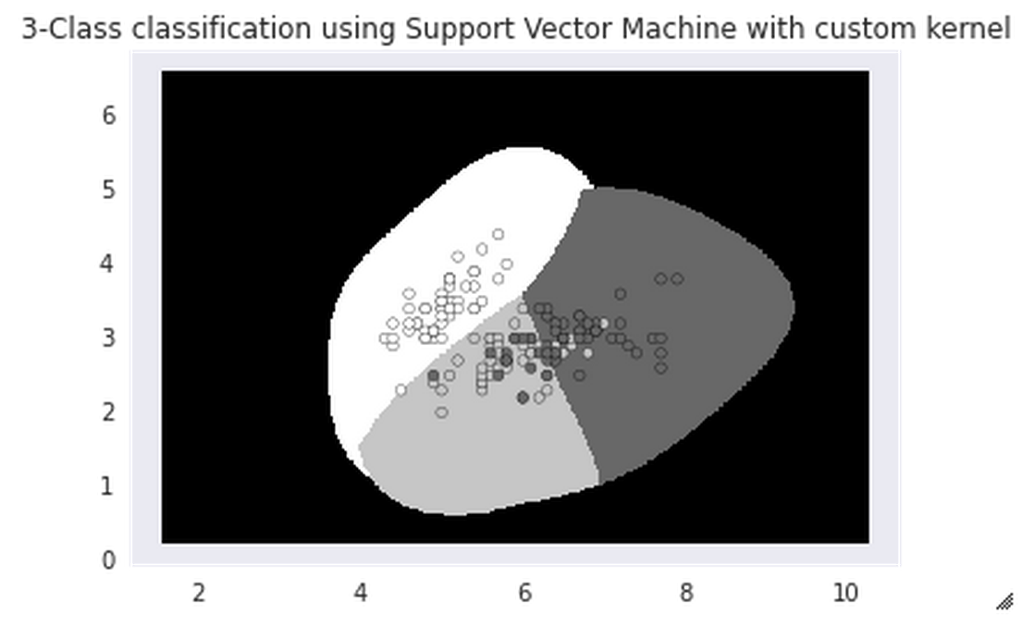
Support Vector Machine - Iris
1 point in outlier class
5 points in outlier class

Slide 6
To Get Code For:
K Nearest Neighbors
K Means
Bayesian Network/Random Forest

